Slide 1
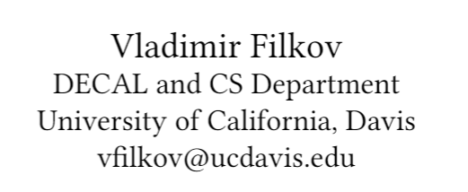
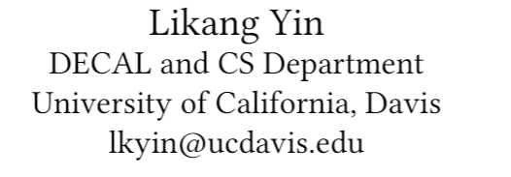




Team Discussions and Dynamics During DevOps Tool Adoptions in OSS Projects

Slide 2







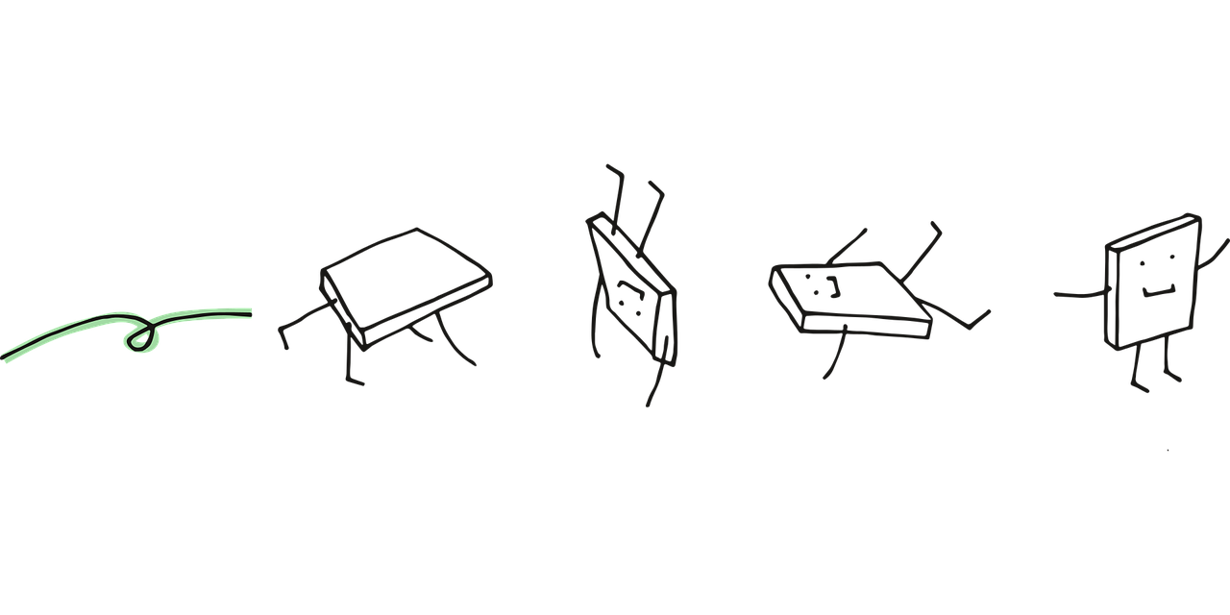
ASE’20
Sep 23, 2020
Continuous Integration Pipeline
Version Control
Build
Testing & Staging
Auto Test
Deployment
The pixel cell is from here: https://pixabay.com/users/manfredsteger-1848497/

Slide 3
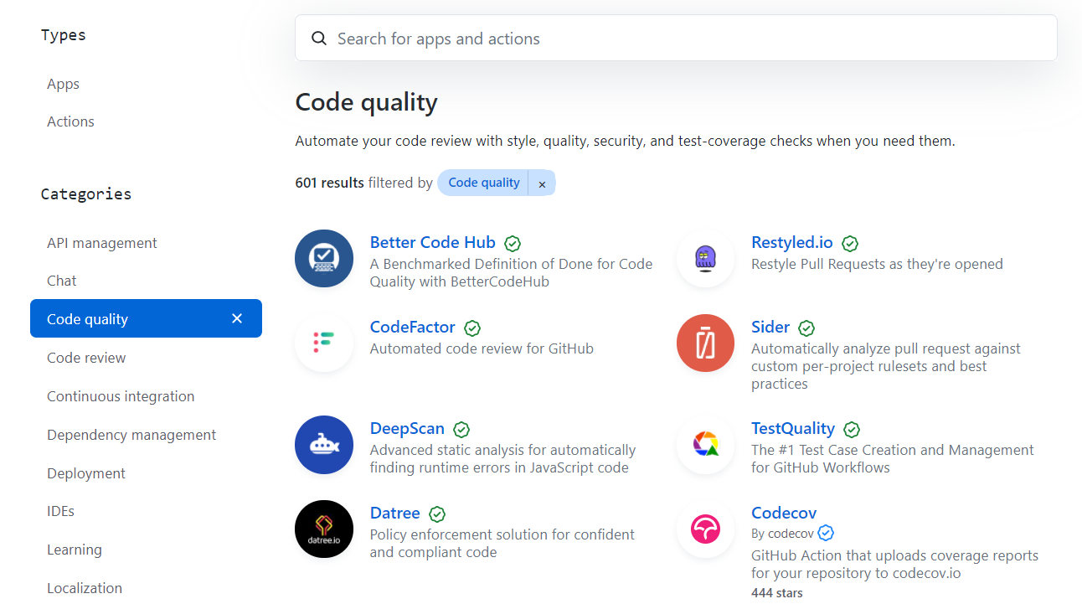
ASE’20
Sep 23, 2020
Pipelines Use Tools, and There are Many

Slide 4
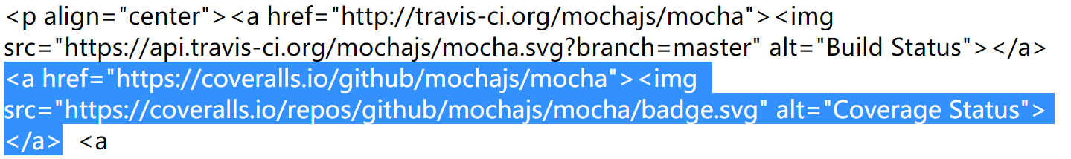
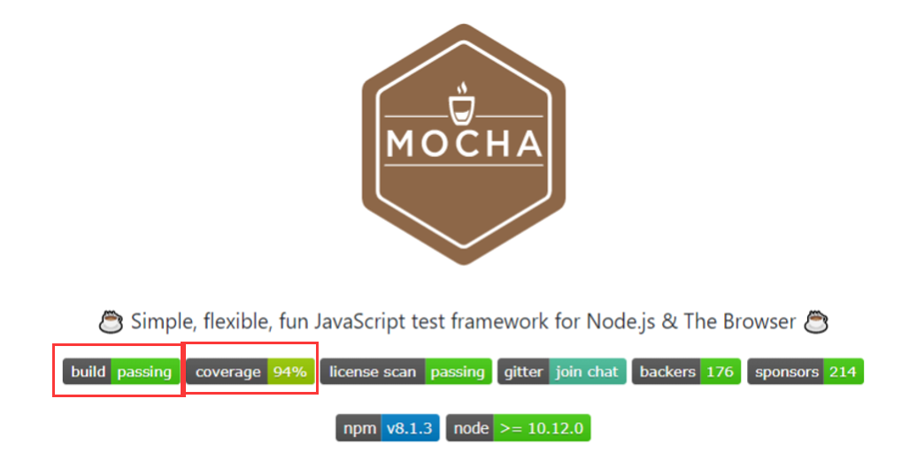
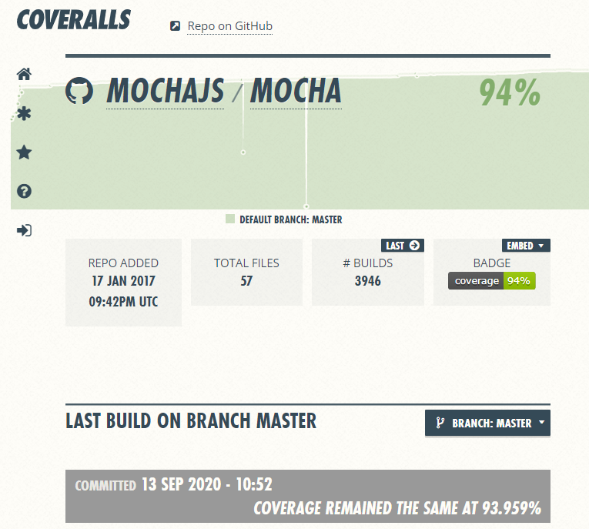
ASE’20
Sep 23, 2020
Badges Show The Tools Being Used

Slide 5

Tool Adoptions in GitHub
Project teams adopt tools all the time.
Many GitHub projects, especially the small and individual projects, do not use any tools.
Adoptions are rarely preceded by meaningful discussions.
Adopting a new tool can affect everyone in the team as they are all stakeholders, making adopting tools a complex process.
There exist issues in the adoption process, and we need to improve it.

Slide 6
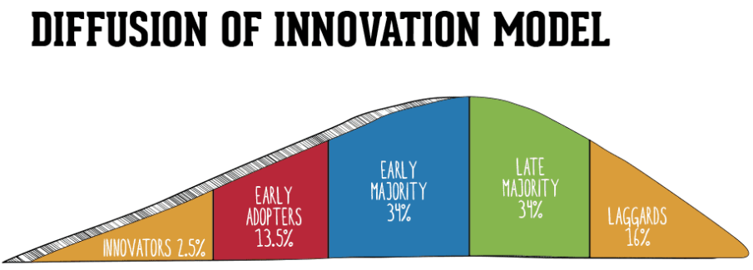
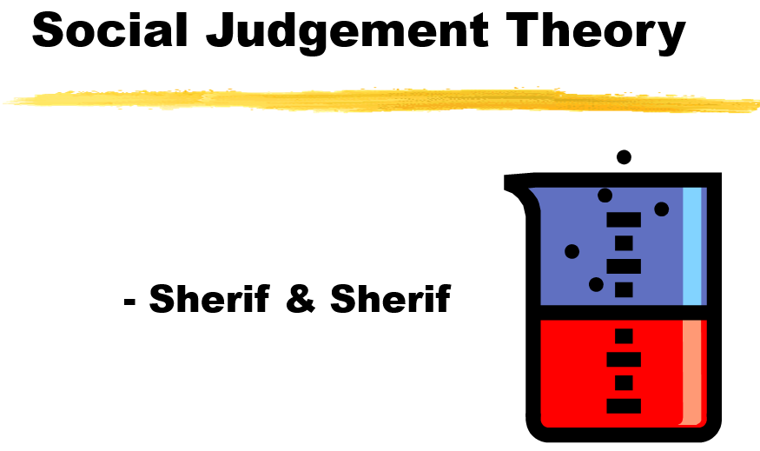
ASE’20
Sep 23, 2020
What Drives Adoptions in Teams?
Diffusion as the process by which an innovation unfolds over time through communication channels among the population.
When people are exposed to new ideas, they tend to consider their previously formed attitude, or anchor to which they compare the new idea. Therefore, people can react very differently.
https://www.smartinsights.com/marketing-planning/marketing-models/diffusion-innovation-model/ https://www.powershow.com/viewht/b7e63-ZDc1Z/Social_Judgement_Theory_powerpoint_ppt_presentation

Slide 7
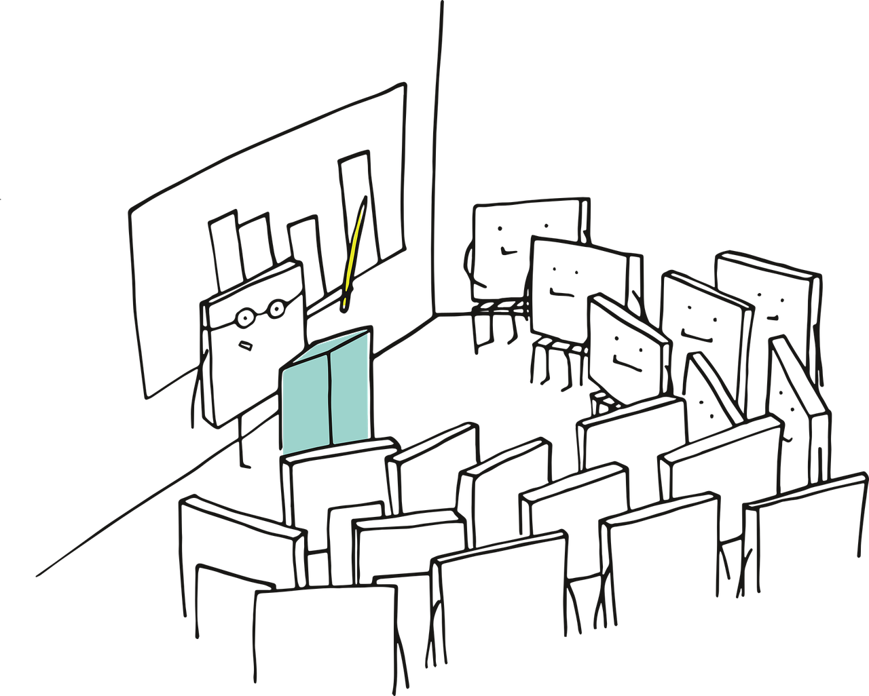


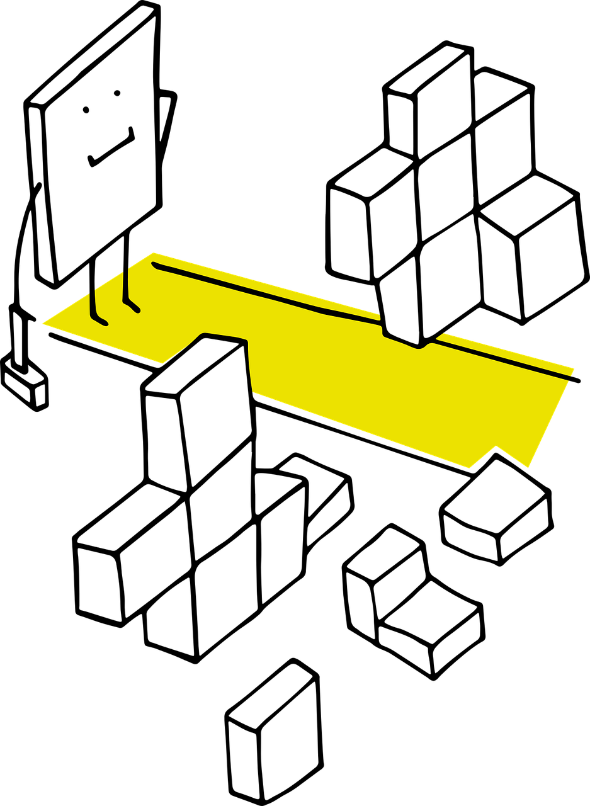
ASE’20
Sep 23, 2020
Communication Means During Tool Adoptions
(a) Social and traditional media
(b) Work/group discussions/learning
(c) One-on-one communication
(d) Other channels

Slide 8
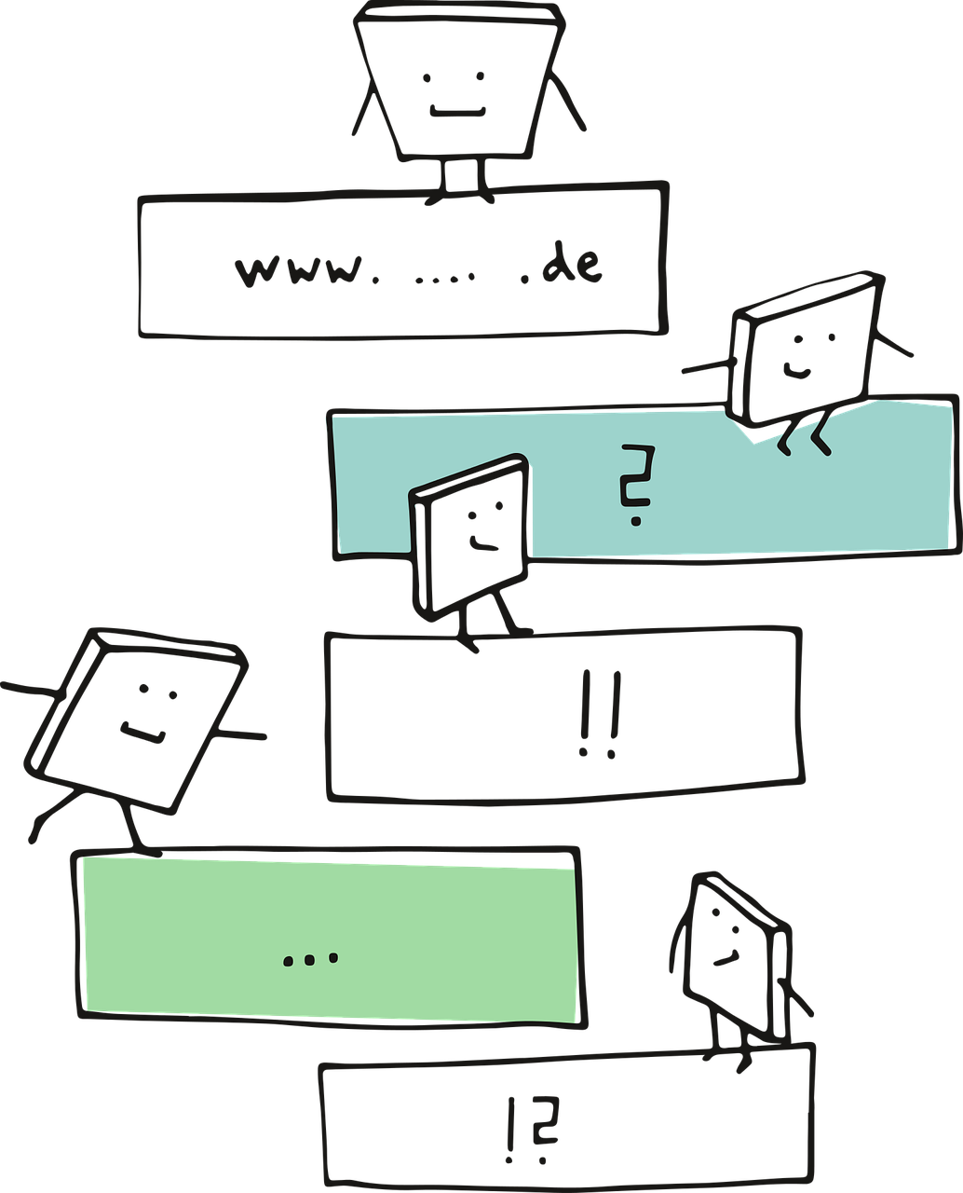
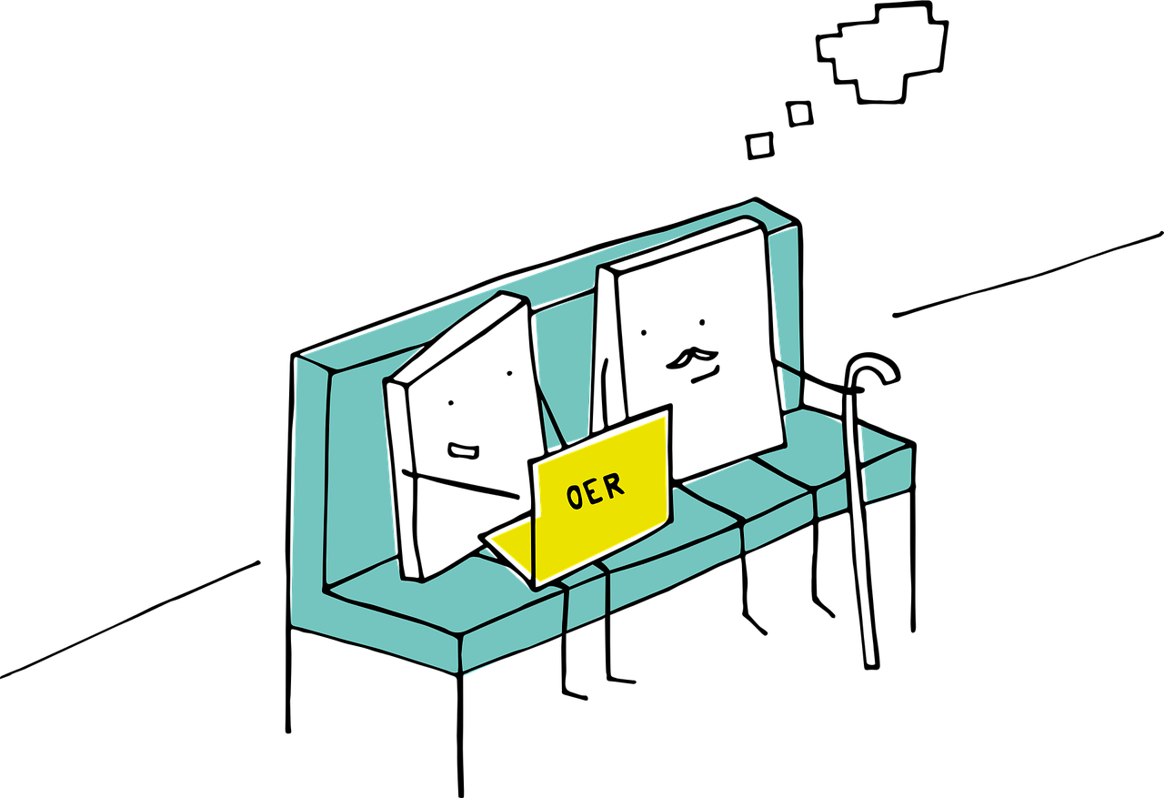

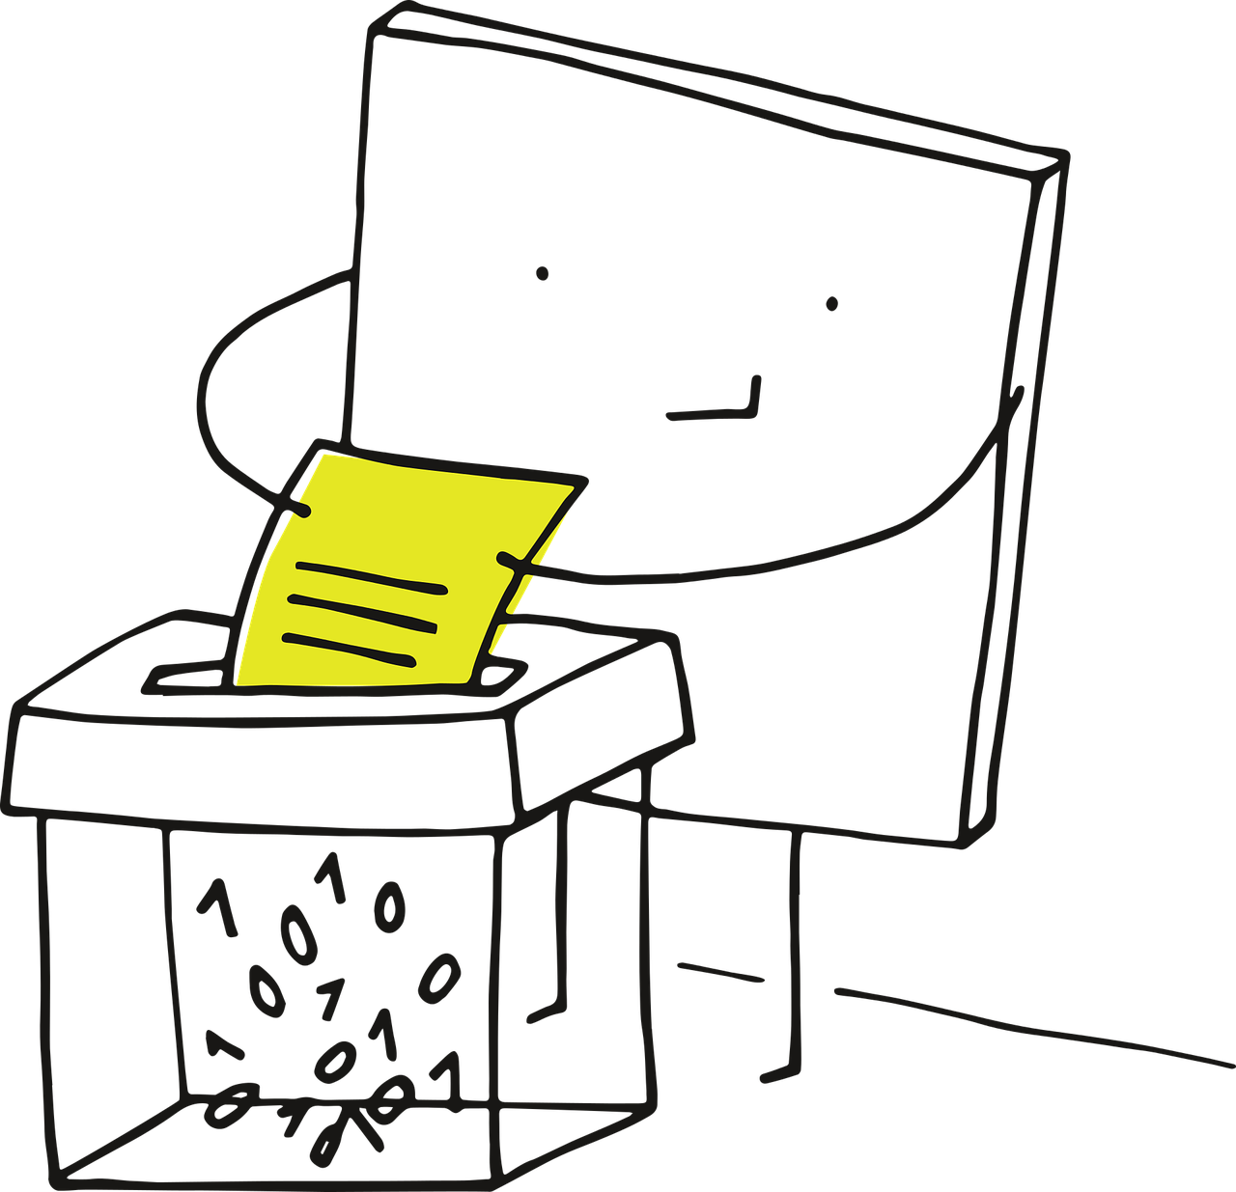
ASE’20
Sep 23, 2020
In OSS Projects We Can Track the Following
Team Discussions
Prior Tool Exposure
Tenure Time

Slide 9


ASE’20
Sep 23, 2020
Experience and Tool Exposure
(a) New Devs vs. Senior Devs
(b) Devs w/ exposure v.s.
Devs w/o exposure to tool
(c) Influencers

Slide 10



Research Questions
ASE’20
Sep 23, 2020
RQ1: What is the social dynamics during tool adoptions?
RQ2: How are people’s sentiments evolving toward the tools?
RQ3: Are tool adoption events associated with influencers?
RQ4: What are the determinants of tool adoptions?

Slide 11

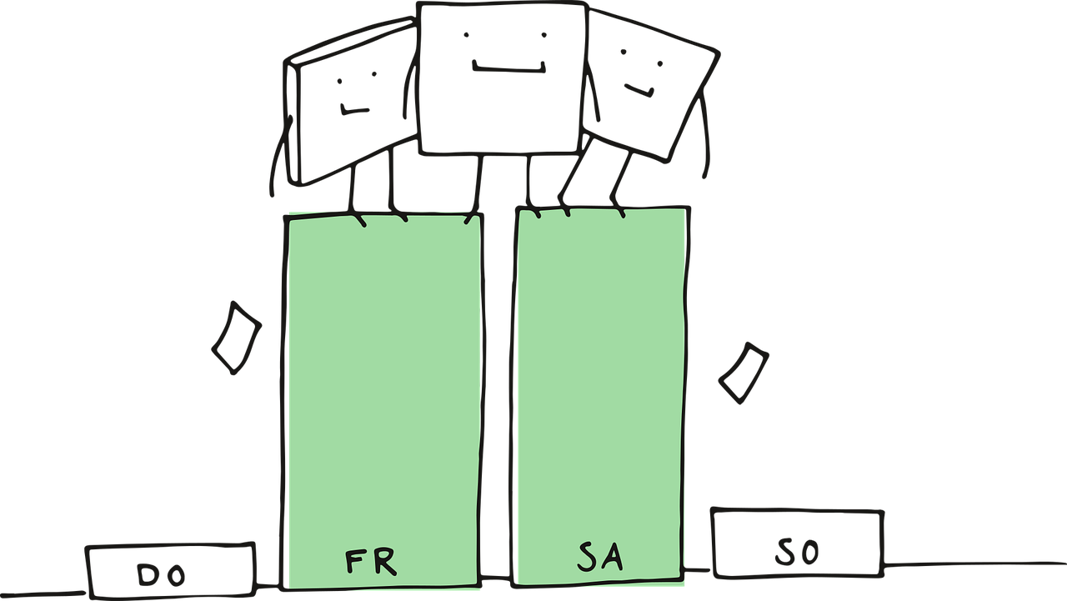


ASE’20
Sep 23, 2020
Research Approach
1. Data collection: 52,923 distinct GitHub projects with 96,176 tool adoptions.
2. Data cleaning: Only keep comments toward tools and remove emojis, URLs, code from comments.
3. Sentiment Analysis: Senti4SD is used to label the sentiment of comments.
4. Case Study: Discussion evolution and influencers.
5. Modeling: Generalized Linear mixed-effects (hierarchical) models (GLMMs).

Slide 12
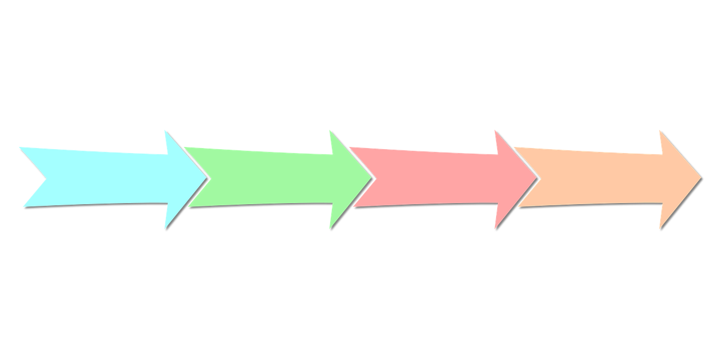


RQ1 Evolution of Adoption Discussion
ASE’20
Sep 23, 2020
Stage IV: Feedback
Stage III: Deciding when to adopt
Stage II: Choosing one tool over others
Stage I: Perceiving demand for tools

Slide 13
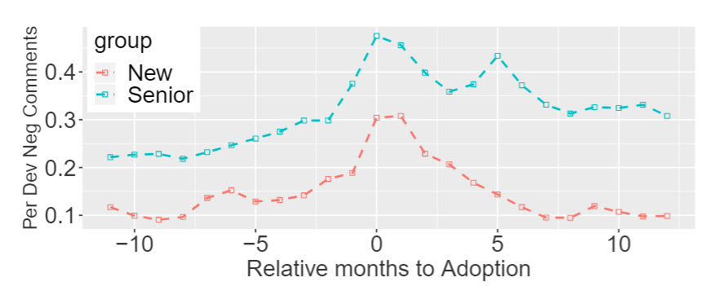
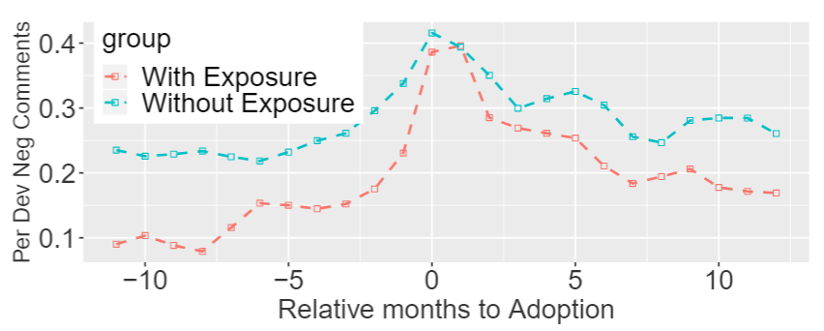
RQ2 Sentiment Dynamics During Tool Adoptions
ASE’20
Sep 23, 2020
New developers, overall, seem to have lower negativity compared to the sentiment of senior developers.
Developers with prior exposure seem to drop the negativity faster and remain a relatively lower negativity to the developers without exposure.

Slide 14
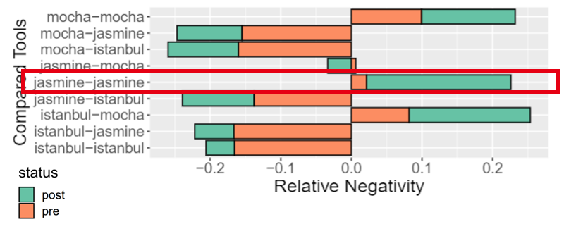



RQ2 Some tools are, different than expected...
ASE’20
Sep 23, 2020
After adopting one the alternative tools, the sentiment of that tool changes, which can become even more negative.
Jasmine

Slide 15
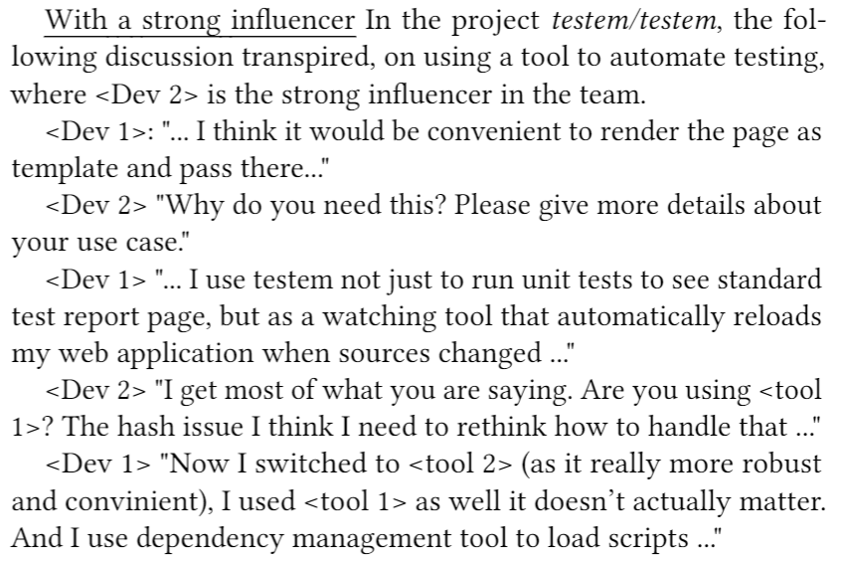
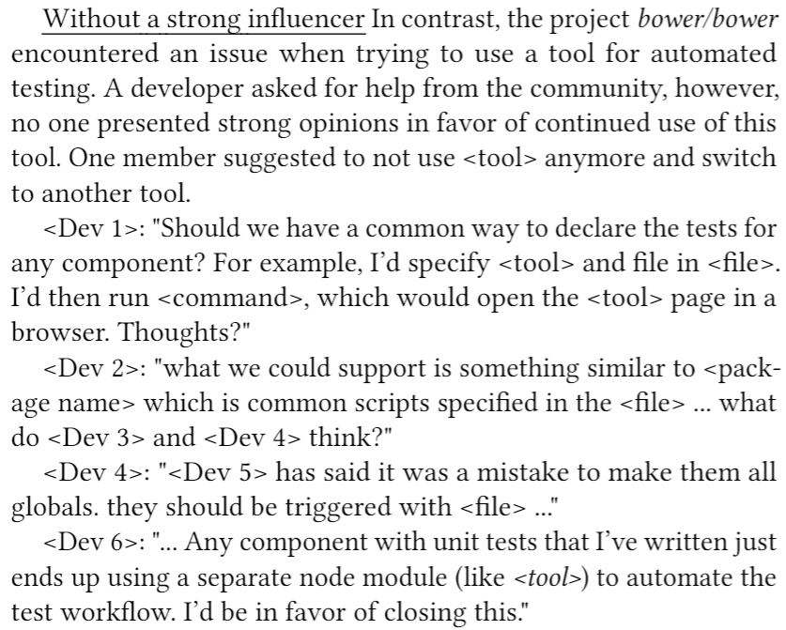
RQ3 Case Study on Influencers
ASE’20
Sep 23, 2020
With Strong Influencers
Without Strong Influencers

Slide 16












ASE’20
Sep 23, 2020
RQ4 Data Modelling
Responses
Mining
Tool Adoption
Discussion Length
Team-level Metrics
New
Involved
w/ Exposure
Positive
Negative
Controls
1,185
sample projects
Project Age
Mentions
Commits
Tool

Slide 17
ASE’20
Sep 23, 2020
RQ4 Modeling
Results
w/ Exposure
Involved
Positive
Negative
New
+
+
_
Succesful Adoption
_
_
+
Project Age
Discussion Time
Mentions
Commits

Slide 18
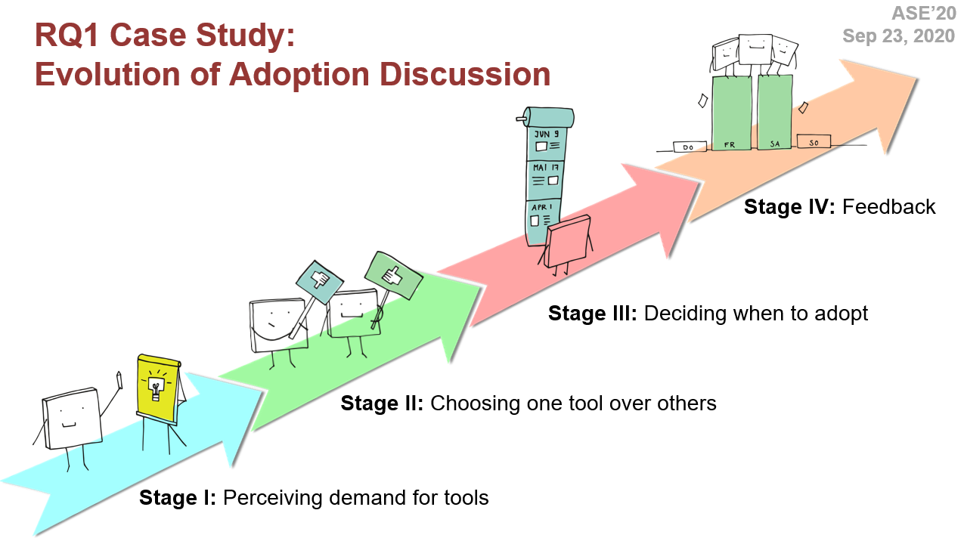
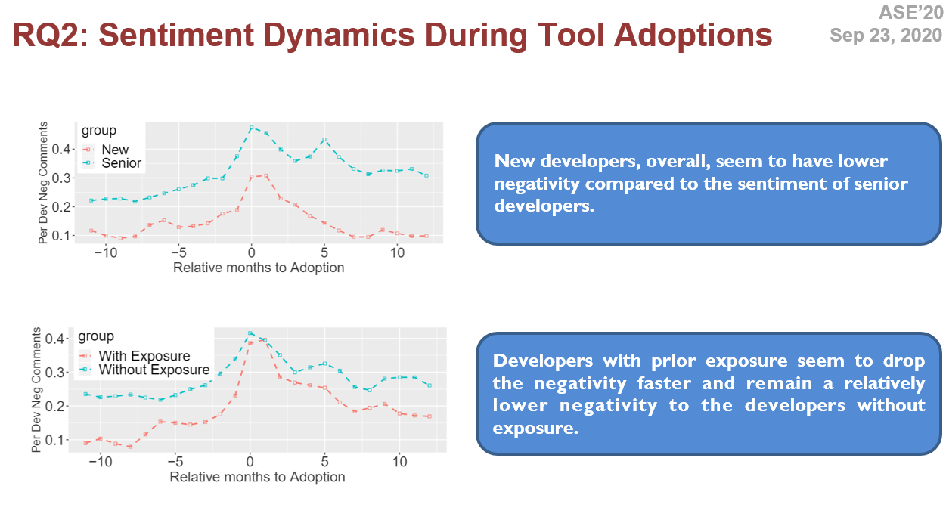
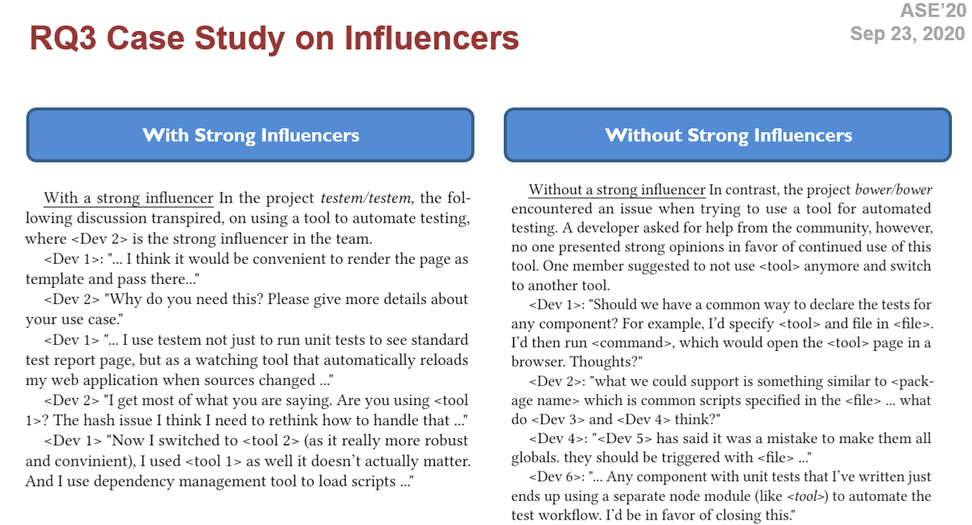
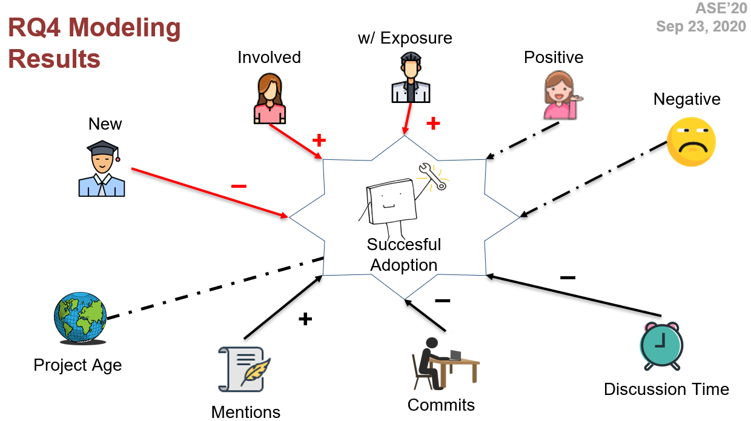
ASE’20
Sep 23, 2020
The Takeaways

Slide 19

Thank you!
A
S
E

